Slide 1
DEEPIKA M
Final Project
3/21/2024 Annual Review

Slide 2
NAMED ENTITY RECOGNITION(NER)
3/21/2024 Annual Review

Slide 3


AGENDA
i.Problem statement
ii.Project overview
iii.Who are the end users?
iv.Your solution and its proposition
v.The wow in your solution
vi.Modeling
vii.Result
3/21/2024 Annual Review

Slide 4

PROBLEM STATEMENT
i.Inefficient processing of IOT sensor data in cloud-based data centers
ii.Need for edge-based machine learning to reduce latency and enable real-time response
iii.Challenges in processing and analyzing large volumes of data at the edge
3/21/2024 Annual Review

Slide 5

PROJECT OVERVIEW
i.Utilizing AI-equipped chips for edge-based machine learning
ii.Processing data closer to its source for improved efficiency and real-time analytics
iii.Importance of balancing cloud-based and edge AI for optimal performance
3/21/2024 Annual Review

Slide 6

WHO ARE THE END USERS?
i.Data scientist:Interested in technical aspects of NER model its integration into existing system
ii.NLP Engineers:Focused on the development and optimization of NLP models ,including for various applications
iii.Researcher:Seeking to advance the field of NLP through experimentation
iv.Companies/Organizations:Looking to enhance their data processing capabilities,automate information extraction
3/21/2024 Annual Review

Slide 7

YOUR SOLUTION AND ITS VALUE PROPOSITION
Solution overview:
i.Developed a bidirectional LSTM model for Named Entity Recognition
ii.Utilizes DL techniques for accurately identifying and classifies entities within unstructured data
Key propositions:
i.Enhanced data processing:Enables efficient extraction of valuable information
ii.Improved decision making:Provide insights into textual data,facilitating informed decision making processes
iii.Automation of tasks:Automates the identification and classification of entities
iv.Flexibility and customization:Offers flexibility to adapt the model to different domains
3/21/2024 Annual Review

Slide 8

THE WOW IN YOUR SOLUTION
i.State of the art technology:
Utilizes techniques like Bidirectional LSTM,for superior performance
ii.High Accuracy:
Achieves high accuracy in entity recognition,surpassing traditional methods
iii.Scalability:
Scales effectively to process large volume of data,ensuring consistent performance
iv.Robustness:
Demonstrates robust performance across various domains,languages and text formats making it versatile and reliable
v.Seamless Integration:
Integrates seamlessly with existing data pipelines
3/21/2024 Annual Review
‹#›

Slide 9
MODELLING
1.Data Loading:
The code likely utilizes libraries like pandas to import the NER dataset from a file format like CSV
2.Handling missing values:
i.Real-world datasets may contain missing entries. The code might handle these missing values by:
ii.Removing rows with missing text or labels
iii.Imputing missing values with common words or average values
3.Text Normalization:
NLP models require consistent text representation. The code might perform normalization techniques like:
i.Lowercasing all text: This ensures consistency and reduces vocabulary size.
ii.Punctuation removal: Punctuation might not be relevant for NER and can be removed.
iii.Tokenization: Splitting the text into individual words or sub-word units(tokens) for model processing.
3/21/2024 Annual Review
‹#›

Slide 10
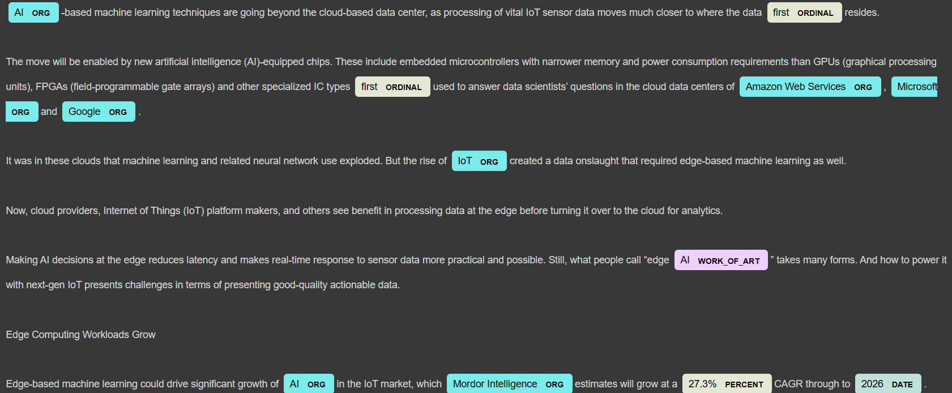
RESULTS
Demo Link
3/21/2024 Annual Review
‹#›

